Slide 1
1. Testing Axioms
2. Software Testing Terms and Definitions
Black-Box and White-Box Testing

Slide 2
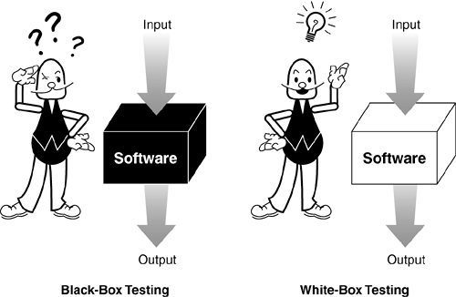
Figure: Black-Box and White-Box Testing

Slide 3
1. Testing Axioms
2. Software Testing Terms and Definitions
Static and Dynamic Testing

Slide 4
1. Testing Axioms
2. Software Testing Terms and Definitions
Precision and Accuracy
Verification and Validation
Quality and Reliability
Testing and Quality Assurance (QA)
Black-Box and White-Box Testing
Static and Dynamic Testing

Slide 5
Quiz:

Slide 6
1. Testing Axioms
2. Software Testing Terms and Definition

Slide 7
Agenda

Slide 8
1. Background
2. Performing a High-Level Review of the Specification
3. Low-Level Specification Test Techniques
4. Inspection
5. Testing the Requirements

Slide 9
1. Background
Requirement
  Definition
  Requirement Development

Slide 10
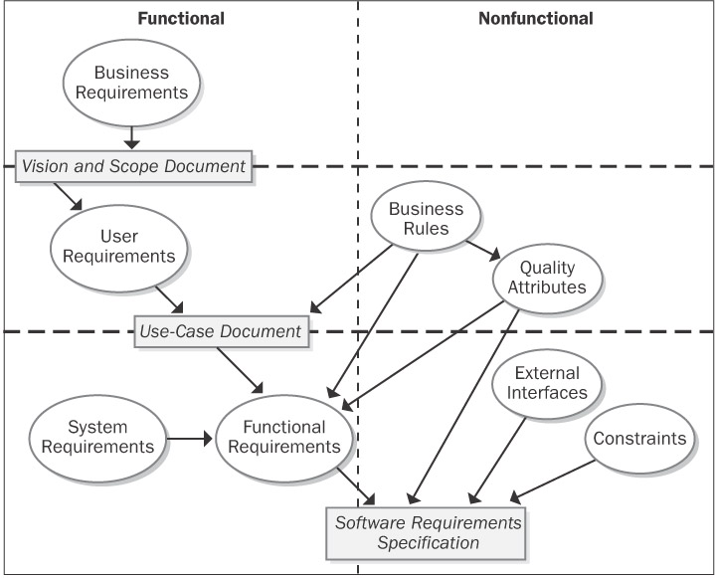

Slide 11
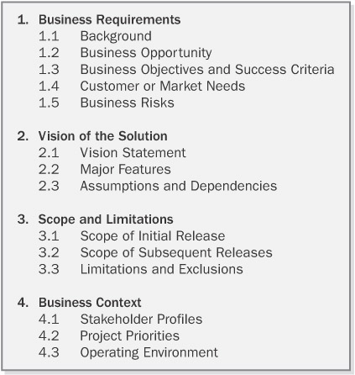
Figure: Why Do Bugs Occur

Slide 12
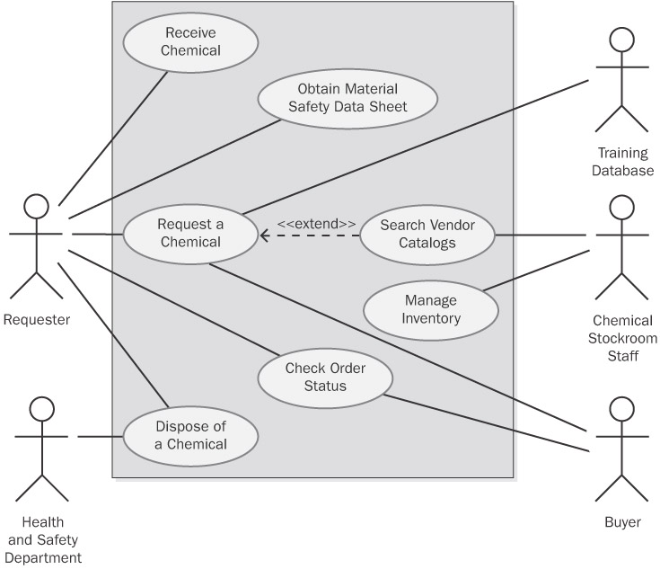
Figure: Why Do Bugs Occur

Slide 13
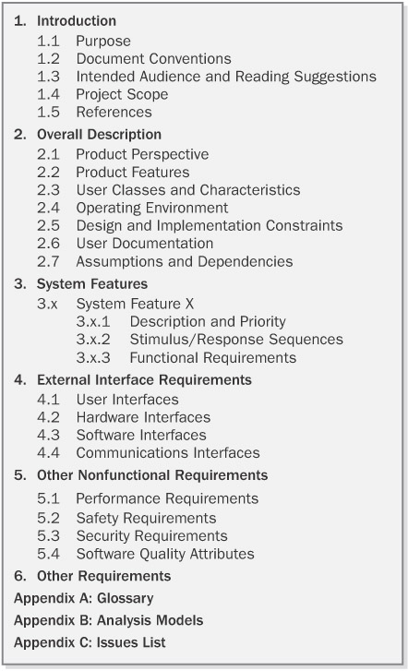
Figure: Why Do Bugs Occur

Slide 14
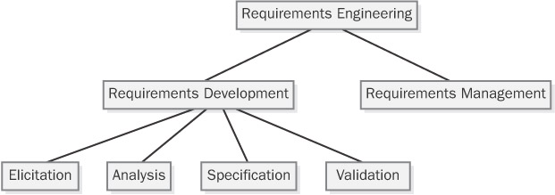
Figure: Why Do Bugs Occur

Slide 15
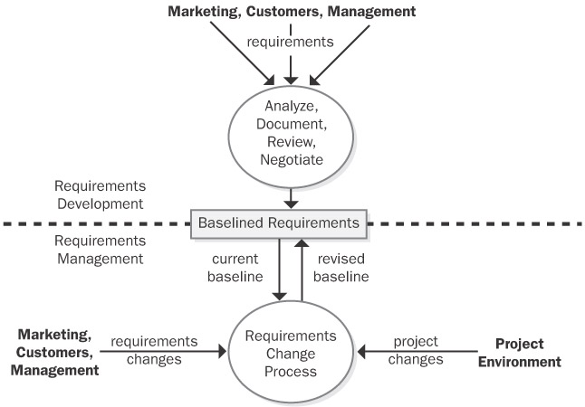
Figure: Why Do Bugs Occur

Slide 16
1. Background
Static Black-Box Testing: Testing the Specification

Slide 17
2. Performing a High-Level Review of the Specification
Pretend to Be the Customer

Slide 18
2. Performing a High-Level Review of the Specification
Research Existing Standards and Guidelines
  Corporate Terminology and Conventions
  Industry Requirements
  Government Standards
  Graphical User Interface (GUI)
  Security Standards

Slide 19
2. Performing a High-Level Review of the Specification
Review and Test Similar Software
  Scale
  Complexity
  Testability
  Quality/Reliability
  Security

Slide 20
3. Low-Level Specification Test Techniques
Specification Attributes Checklist
  Complete
  Accurate
  Precise, Unambiguous, and Clear
  Consistent
  Relevant
  Feasible
  Code-free
  Testable

Slide 21
3. Low-Level Specification Test Techniques
Specification Terminology Checklist
  Always, Every, All, None, Never.
  Some, Sometimes, Often, Usually, Ordinarily, Customarily, Most, Mostly.
  Etc., And So Forth, And So On, Such As.
  Good, Fast, Cheap, Efficient, Small, Stable.
  Handled, Processed, Rejected, Skipped, Eliminated.
  If…Then…(but missing Else).

Slide 22
4. Inspection
  Participants
  Roles
  Entry Criteria
  Inspection Stages
  Exit Criteria
  Defect Checklists

Slide 23
5. Testing the Requirements

Slide 24
1. Getting Started
2. Performing a High-Level Review of the Specification
3. Low-Level Specification Test Techniques
4. Inspection
5. Testing the Requirements

Slide 25
Task:
  Inspection
  Testing the Requirements
Question:

